Slide 2
Office365 & Intune: Seguridad y protección de datos
Alessandro Cesarini
Madalina Florea
Irene Higuera

Slide 3
O365 Security & Protection

Slide 4

How to protect your Information with O365
Data Loss Prevention
Retention Hold
Auditing
Compliance Cases (eDiscovery)
Device Security Policies
Retention Tags

Slide 5
Data Loss Prevention

Slide 6




Data loss prevention in Microsoft Office
Helps to
identify • monitor • protect
sensitive data through deep content analysis
Identify
Monitor
Protect
End user education

Slide 7





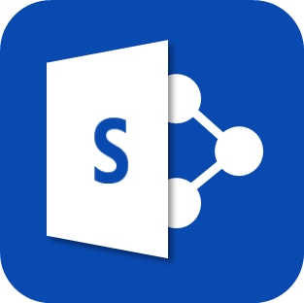


Unified Policy Distribution
ADMIN
DLP policy configuration
PROTECTION CENTER POLICY STORE
Policy distribution
across workloads

Slide 8




DLP: Policy Application
Audit content aggregation
Backend policy evaluation
Contextual policy education
!
INFORMATION WORKERS

Slide 9
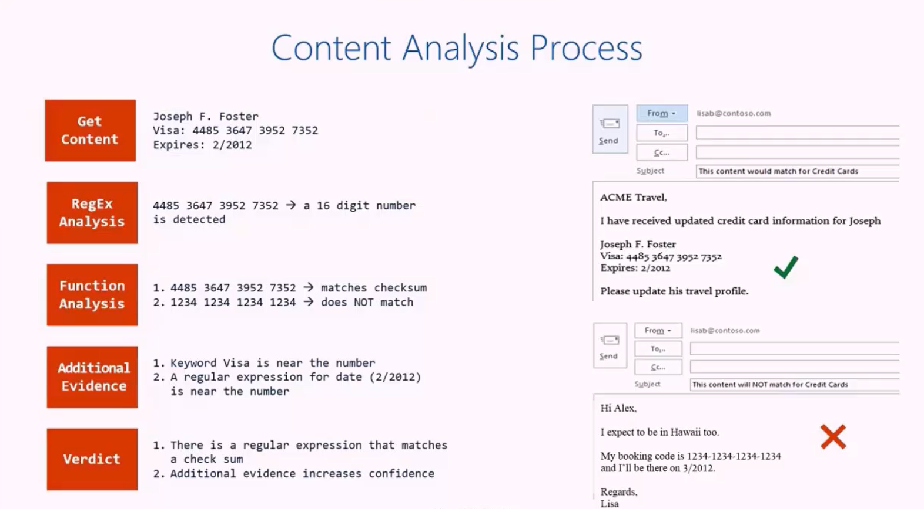
Content Analysis Process
Get Content
Joseph F. Foster
Visa: 4485 3647 3952 7352
Expires: 2/2012
RegEx Analysis
4485 3647 3952 7352
A 16 digit number is detected
Function Analysis
4485 3647 3952 7352: matches checksum
1234 1234 1234 1234: does not match
Additional Evidence
Keyword Visa is near the number
A regular expression for date is near the number
Veredict
There is a regular expression that matches a check sum
Additional evidence increases confidence

Slide 10
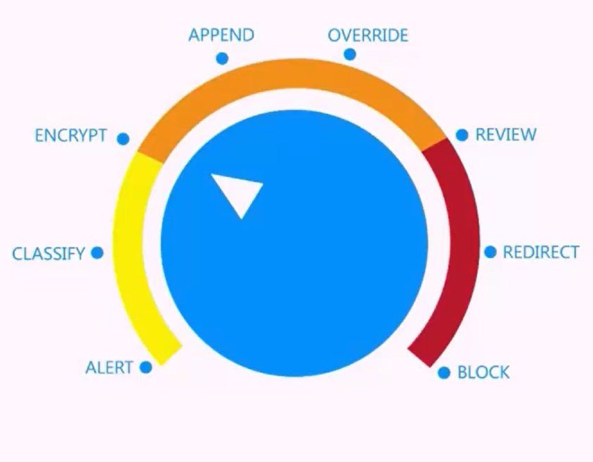
Enforcement Actions

Slide 11
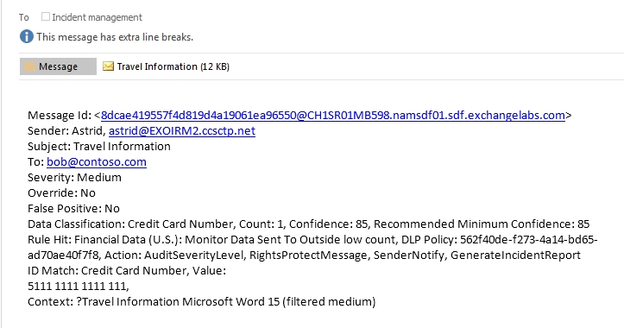
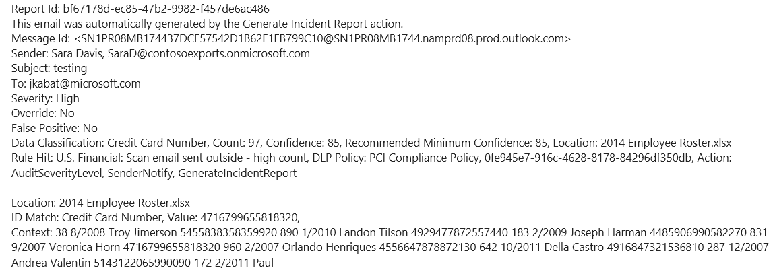
Incident Reports
AUDIT DATA
RULE DETAILS
CLASSIFICATION
MATCH DETAILS

Slide 12
Demo

Slide 13
Retention Hold
Notes:
RENTENTION HOLD
+ Deletion
+ Preservation
A preservation policy can preserve content for a specific time period, and at the end of that time period, the content’s automatically released from the policy
The policy can also be locked so that no one can turn off the policy or make it less restrictive
If you need to hold content as part of a legal or eDiscovery requirement, use an eDiscovery hold. For example, if you need to hold content in specific locations as part of a legal request, use an eDiscovery hold. In eDiscovery, the content relevant to a case is typically sensitive or privileged, so different cases can be restricted to different members. In addition, eDiscovery supports content searches that can be saved, previewed, analyzed with Advanced eDiscovery, or have the results exported.
Unlike a preservation policy, an eDiscovery hold cannot specify a time period – an eDiscovery hold is in effect until you turn it off or delete it. Also, an eDiscovery hold cannot be locked.

Slide 14
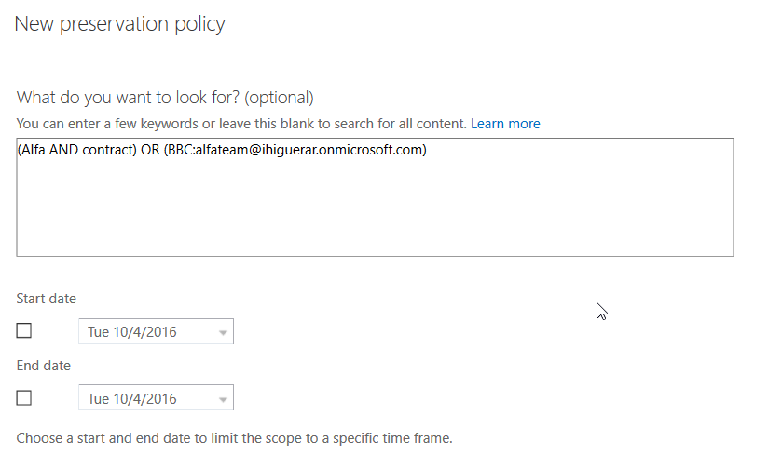
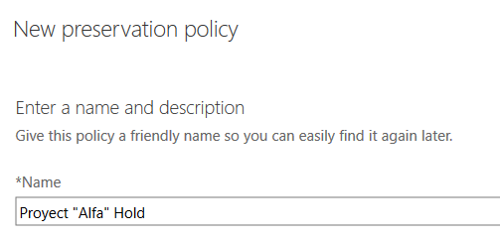
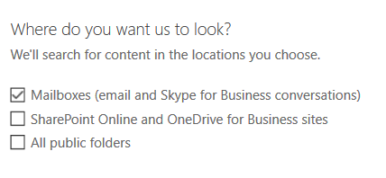
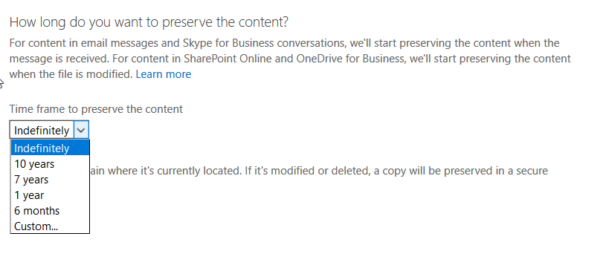
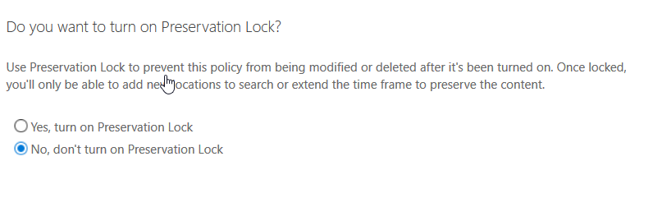
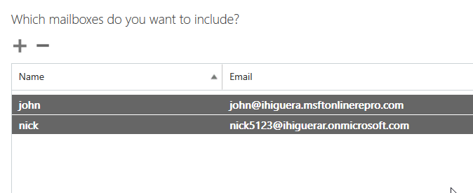
Enable Retention Hold

Slide 15
Where all content is stored?
Regular content is stored in System or Personal folders
Only deleted items or items versions are stored in Recoverable items

Slide 16
Hold Quota?
In Exchange Online, the quota for the Recoverable Items folder is automatically increased to 100 GB when you place a mailbox on Litigation Hold. The default size of this folder is 30 GB.

Slide 17
What happens if user reachs quota?
No more entries will be added
User can access mailbox but is unable of deleting items or delete all content from deleted items folder
Contact Support to increase quota

Slide 18
Auditing

Slide 19
O365 Auditing
Copia/creación/visualización/movimiento de elementos en un buzón
Acceso a carpetas
Eliminación de elementos
Acceso a buzón
Envío como / Envío en nombre de
Cambio de propiedades de un elemento, etc.

Slide 20
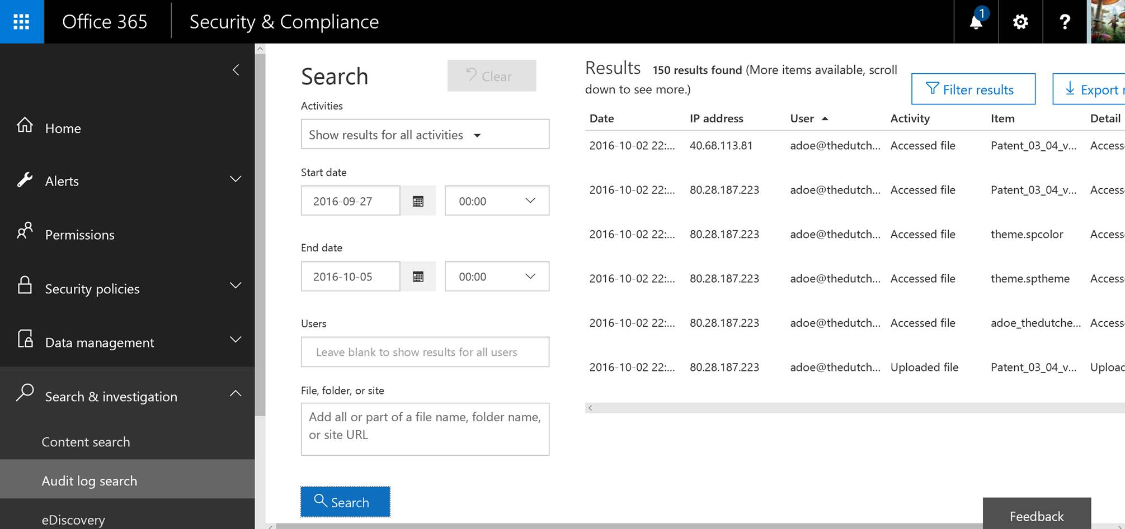
New Audit Portal

Slide 21
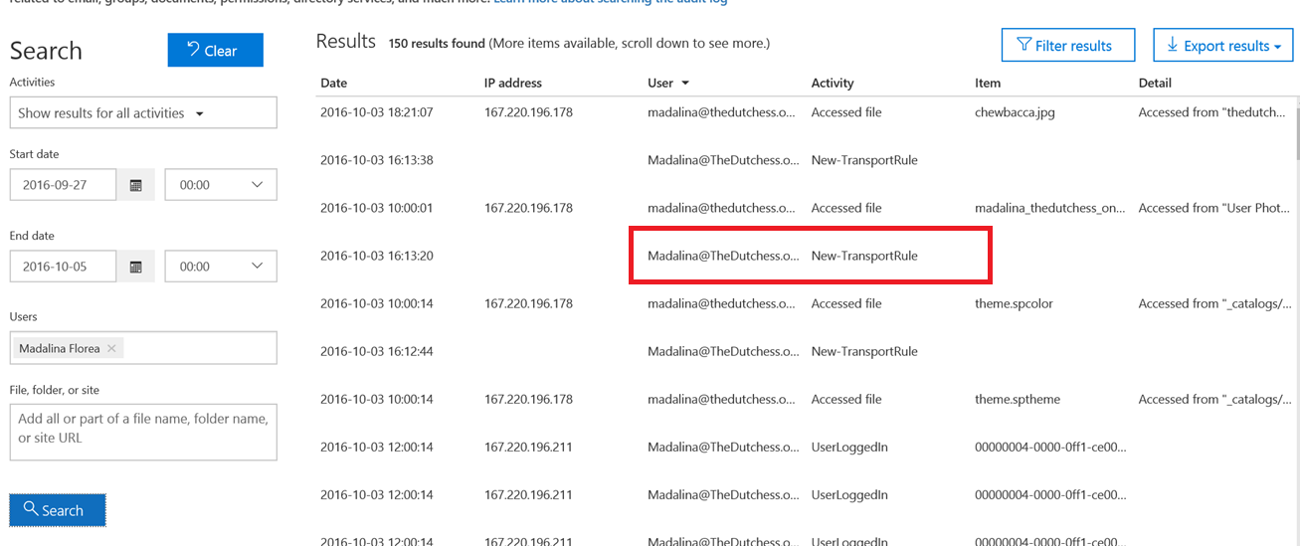
Admin Audit

Slide 22
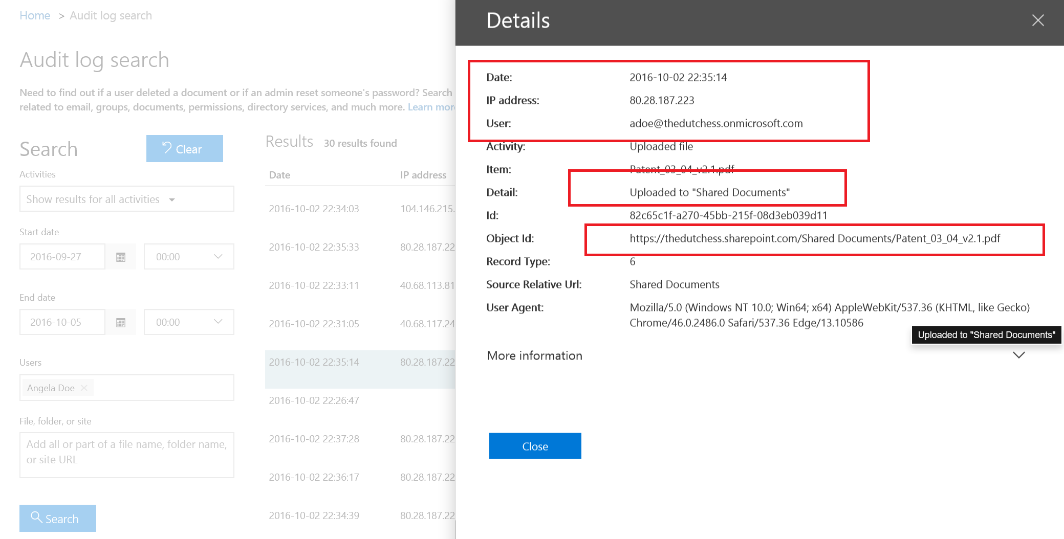
User Audit

Slide 23
Advanced protection with Intune

Slide 24




Conditional Access
Policy compliance verification
Microsoft Office SharePoint
Online
Microsoft Exchange
Online
Device management
SharePoint
Online
Exchange
Online
Device compliance
User
User
Measured boot integrity status (Windows PPCH)
Policy verification
Advanced device compliance (antivirus, firewall, patch state, etc.)
Windows 10
Microsoft Intune
Microsoft Intune
Windows Provable PC Health (PPCH)
System Center
ConfigMgr
Notes:
Corporate email is one of the most important resources that employees need to access in order to be productive. But organizations want to keep corporate information secure by restricting access on devices that are not enrolled or not compliant with corporate policies. In the scenario that you see here, a user has enrolled a device into the Intune service and is now trying to access corporate email by using Microsoft Office 365 or Exchange on-premises. Based upon the settings defined by the IT administrator at the user’s company, the user’s device is still not compliant. During the policy verification process performed by Intune, the user’s access is blocked until the device is encrypted, a passcode is set, and the device is no longer jailbroken or rooted.
Now, if a user tries to access corporate email and their device is not enrolled or not compliant based upon the settings defined by the IT admin, the user experience is pretty intuitive. The user will receive an email explaining why access has been blocked with steps for how to resolve the issue.
With Windows 10, Intune can verify additional device compliance attributes such as antivirus status, firewall status, update state, and can verify measured boot integrity status by using the Windows Provable PC Health service.

Slide 25















Managing Mobile Apps: How it Works
Multi-identity policy
Managed apps
Managed apps
Corporate
data
Personal
data
User
IT
Maximize mobile productivity and help protect corporate resources with Microsoft Office mobile apps – including multi-identity support
Extend these capabilities to your existing line-of-business apps using the Microsoft Intune App Wrapping Tool
Personal apps
Personal apps
Enable secure viewing of content using the Managed Browser, PDF Viewer, AV Player, and Image Viewer apps

Slide 26



Mobile application management
Managed apps
Email
attachment
User
Copy
Paste
Save
Paste to personal app
Save to personal storage
Personal apps
Maximize productivity while preventing leakage of company data by restricting actions such as copy, cut, paste, and save as between Intune-managed apps and unmanaged apps
Notes:
Admin
Creates Mobile Application Management policies
Associates the policy to the app
Existing apps can be restricted by policies
In-house, you can be repackaged using App Wrapping tool
Deploys it to users or devices
User
End users can install managed apps
Users can only move or share data between managed apps
https://technet.microsoft.com/en-us/library/mt574220.aspx

Slide 27


Windows Information Protection for Windows 10
Configure and manage WIP policies with Intune and Azure Rights Management
Microsoft Intune
&
Azure Rights Management
Separate personal and corporate data with limited impact to employee’s day-to-day activities
Control app access to corporate data and prevent copy and paste-related data leaks
Apply policies
Save
Protect data at rest and wherever it may roam*
File share
User
Secure content collaboration through integration with Azure Rights Management
Save
Personal storage
Share files and
enforce policies
Corporate network
* Some roaming scenarios use Azure Right Management
Notes:
With the increase of employee-owned devices in the enterprise, there’s also an increasing risk of accidental data disclosure through apps and services that are outside of the enterprise’s control like email, social media, and the public cloud.
Many of the existing solutions try to address this issue by requiring employees to switch between personal and work containers and apps, which can lead to a less than optimal user experience. The Windows 10 feature code-named Windows Information Protection (WIP) offers a better user experience, while helping to better separate and protect enterprise apps and data against disclosure risks across both company and personal devices, without requiring changes in environments or apps. Additionally, WIP when used with Azure Rights Management (RMS) can help to protect your enterprise data locally, persisting the protection even when your data roams or is shared.
With Intune, IT admins can manage WIP policies to protect corporate data (this is similar to the Intune MAM capabilities for iOS and Android). Additional management capabilities for data protection and separation are also available with Windows 10.
Note: With WIP, you can protect Windows 10 apps and data without the need for an App Wrapping Tool or App SDK.

Slide 28
WIP Protection Modes
Block
WIP stops employees from completing inappropriate data sharing practices.
Override
WIP warns employees if they do something deemed potentially unsafe. This management mode lets the employee override the policy and share data, and logs the action to the audit log.
Silent
WIP logs inappropriate data sharing without blocking. Un-allowed actions, like apps inappropriately trying to access a network resource or WIP-protected data, are still blocked.
Off
No protection or auditing of data.
Notes:
Block: WIP looks for inappropriate data sharing practices and stops the employee from completing the action. This can include sharing info across non-enterprise-protected apps in addition to sharing enterprise data between apps or attempting to share outside of your organization’s network.
Override: WIP looks for inappropriate data sharing, warning employees if they do something deemed potentially unsafe. However, this management mode lets the employee override the policy and share the data, logging the action to your audit log, accessible through the Reporting CSP.
Silent: WIP runs silently, logging inappropriate data sharing, without blocking anything that would’ve been prompted for employee interaction while in Override mode. Un-allowed actions, like apps inappropriately trying to access a network resource or WIP-protected data, are still blocked.
Off: WIP is turned off and doesn't help to protect or audit your data. After you turn off WIP, an attempt is made to decrypt any closed WIP-tagged files on the locally attached drives.

Slide 29
WIP Protection Modes
Corporate Data & Apps
Private Data & Apps
Block
User is not allowed to copy/paste data
Override
User gets prompted if he/she wants to copy/paste data
Y/N
Y/N
Silent
User copy/paste data, but gets audited
Logging
Off
No WIP
Encrypted
Unencrypted
Notes:
When taking a look at the user interactions depending on the WIP protection modes, the following can be said:
All corporate data and apps are encrypted using WIP
All private data and apps are unencrypted
When Block is applied within the WIP Policy as the protection mode: The user is not allowed to copy/paste corporate data to personal apps.
When Override is applied within the WIP Policy as the protection mode: The user gets prompted if they want to copy/paste corporate data to personal apps.
When Silent is applied within the WIP Policy as the protection mode: The user can copy/paste corporate data to personal apps, but gets audited.
When Off is applied within the WIP Policy as the protection mode: No WIP is applied.

Slide 30


WIP Protection Overview
Corporate Data & Apps
Block
Private Data & Apps
Can copy/paste but encrypted
USB
Can attach and/or transfer the data decrypted
Email
OneDrive for Business
Local directory
Excel
Remote File Share
Encrypted
Notes:
The following slides explains various use cases of how WIP works.
This slide summarizes what WIP can do currently:
All corporate data can be stored encrypted on a user’s desktop PC.
Corporate data cannot be saved as private data (reclassification) when Block is in place.
It is possible to transfer data on a USB stick with the data remaining encrypted.
When attaching a file to an email or saving it to a remote file share, the file is shared decrypted (not WIP protected) as it leaves the device.

Slide 31
WIP Protection Use Cases – Copy / Paste
Enlightened app to Enlightened app
Copy content from an organization’s Word document and then paste it into the Facebook tab of the Edge browser.
Block*
Copy content from an organization’s Word document and paste it into the Excel Online tab of the Edge browser.
a
Copy content from personal Word document and paste it into the Excel Online tab of the Edge browser.
a
*depending on policy’s protection mode
Notes:
Let’s take a look at the specific behavior of WIP by traversing several use cases.
We start with the Copy/Paste scenario between two enlightened apps: Word Mobile and the Edge Browser. Both apps are added to the App Rules within the WIP policy. Furthermore, the corporate Excel Online URLs are added to the network domains.
When we copy content from the organization’s Word document and paste it into the Facebook tab of the Edge browser this action is blocked – depending on the protection mode which is set in the WIP policy. If override is selected for this, a pop up appears giving the user the option to select between Allow and Block.
When we copy content from the organization’s Word document and paste it into the corporate Excel Online tab of the Edge browser, this action is allowed.
If we copy content from a personal Word document and paste it into the corporate Excel Online tab of the Edge browser, this action is allowed.

Slide 32
WIP Protection Use Cases – Copy/Paste
Unenlightened app to Enlightened app
Copy content from a LOB app and paste it into the Facebook tab of the Edge browser.
Block*
Copy content from a LOB app and paste it into the Excel Online tab of the Edge browser.
a
Copy content from a personal app and paste it into the Excel Online tab of the Edge browser.
a
*depending on policy’s protection mode
Notes:
Let’s now take a look at the Copy/Paste scenario from an unenlightened app (e.g. a Line of Business “LOB” application) to an enlightened app (i.e. the Edge browser). Both apps are added to the App Rules within the WIP policy. Furthermore, the corporate Excel Online URLs are added to the network domains.
If we copy content from the LOB app and paste it into the Facebook tab of the Edge browser, this action is blocked – based on the protection mode set in the WIP policy. If the override is selected for this, a pop up appears giving the user the option to select between Allow and Block.
If we copy content from the LOB app and paste it into the corporate Excel Online tab of the edge browser, this action is allowed.
If we copy content from a personal app and paste it into the corporate Excel Online tab of the Edge browser, this action is allowed.

Slide 33
WIP Protection Use Cases – Copy/Paste
Unenlightened app to Unenlightened app
Copy content from a LOB app and paste it into another LOB app.
a
Enlightened app to Unenlightened app
Copy content from the Facebook tab of Edge browser and paste it into a LOB app.
a
Copy content from the Excel Online tab of Edge browser and paste it into a LOB app.
a
*depending on policy’s protection mode
Notes:
Let’s now take a look at the Copy/Paste scenario from an unenlightened app (e.g. a LOB app) to an unenlightened app (e.g. a different LOB app). Both apps are added to the App Rules within the WIP policy.
If we copy content from one LOB app to another LOB app, this action is allowed.
If we copy/paste content from an enlightened app (e.g. the Edge browser) to an unenlightened app (e.g. a LOB app), adding both apps to the App Rules and adding the corporate Excel Online URLs to the network domains, the following is allowed:
Copy content from Facebook tab of Edge browser and paste it into a LOB app.
Copy content from corporate Excel Online tab of Edge browser and paste it into a LOB app.

Slide 34
Protect corporate data with Windows 10
Device protection
Data separation
Leak protection
Sharing protection
BitLocker
Device Guard
Device settings
Windows Defender
Windows
Information
Protection
Rights Management
Windows 10
Microsoft Configuration Manager and or Intune
Azure Rights Management
Notes:
Windows 10 coupled with Azure Rights Management and Microsoft Intune provide the comprehensive set of capabilities they you need to cover each of these areas.
BitLocker, Device Guard, device settings, and Windows Defender provide comprehensive protection of the device and operating system. These settings can be managed by Microsoft Intune.
Using Windows Information Protection in Windows 10, you can separate corporate and personal data, enabling corporate data to easily be wiped and make sure that only authorized applications can access your corporate data.
When it comes to Leak Protection, as you can see on this slide, Windows Information Protection, also provides basic leak protection. It will help ensure that corporate data can’t be leaked with actions such as copy, paste, and “save as”. For those looking for advanced leak protection like the ability to prevent printing or forwarding of documents or email Azure Rights Management is there to take things to the next level. With Microsoft Intune, you can manage WIP policies to enforce data separation as well as prevent leakage of corporate data by preventing actions such as copy, paste, and “save as”.
Then finally when it comes to Sharing Protection, meaning sharing protected content, whether that’s B2B, B2C or sharing a sensitive document to just a select few within your organizations Azure Rights Management is there to cover you.

Slide 35
Demo

Slide 36

Gracias
http://aka.ms/MTS91
#TechSum

Slide 37
Notes:
Muchas gracias Alessandro e Irene, ya me quedo mas tranquila sabiendo que puedo controlar el acceso a mi información corporativa utilizando Office365 y W.Intune

